Slide 1



Improving DNN Inference Throughput Using Practical, Per-Input Compute Adaptation
Anand Iyer, Mingyu Guan, Yinwei Dai, Rui Pan, Swapnil Gandhi, Ravi Netravali
SOSP 2024
Notes:
Today, I will be talking about our work on improving DNN inference throughput using practical, per-input compute adaptation. This is a joint work with our collaborators at Princeton and Stanford.

Slide 2

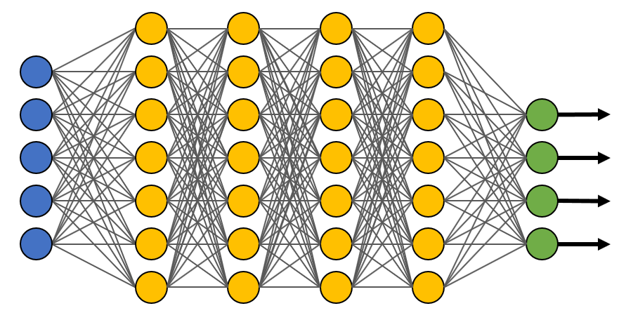

DNN Inference
“Chihuahua”
Symposium on Operating System
“Principles”
“Playing with a blue ball”
What is the cat doing?
MultiRay powers over 125 use cases, serving 800 billion queries per day - Meta
ONNX runtime processes ~1 trillion inferences per day - Microsoft
Today we serve more than 20,000 inference queries per second – Character.AI
Notes:
ML inference, the process of deploying trained models to serve queries, has become a dominant and critical workload that underlies many real-world applications. Today, industry scale systems face significant demand to serve such queries. For instance, companies such as Meta, Microsoft and even startups have indicated that they are facing billions of queries per day. This number is expected to continue to rise, as ML powered services grow in popularity.

Slide 3

DNN Model Sizes
Courtesy: EpochAI.org
Notes:
At the same time, DNN models have steadily increased in size. A recent survey conducted by research institute EpochAI reveals that over the past decade, the number of trainable parameters in DNN models have doubled every year for the last decade. Currently, it is common to find models with several billions of parameters with some models even breaching the trillion parameters mark.

Slide 4
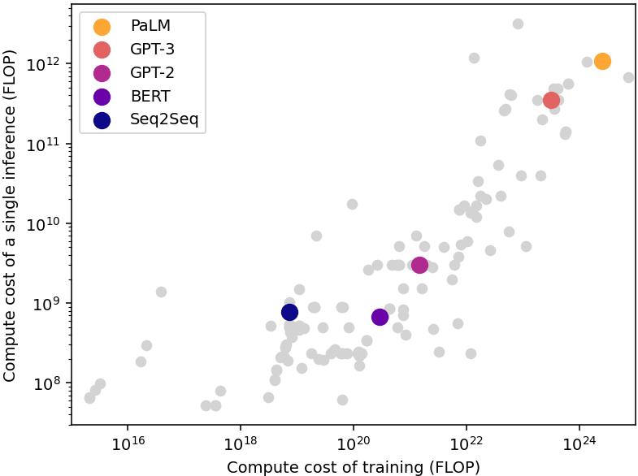

Compute Requirements
Growing demand + model sizes = significant computation requirements
Aggregate inference cost over a model’s life can far exceed training
Cost of individual inference is increasing significantly
Requires large clusters of costly accelerators (e.g., GPUs)
Critical to reduce compute and improve resource utilization
Notes:
Such growth in demand for inference and model size places immense pressure in terms of the computation requirements. Although initially it may look like training compute demands dwarf inference, the aggregate cost over the lifetime of a deployed model will far exceed training cost. Since the compute cost of inference is roughly proportional to the model size, increasing model size also have started contributing significantly to this problem. As a result, industry grade inference serving systems require large clusters of GPUs to support workload demands. Therefore, reducing the compute overheads and thereby improving resource utilization is paramount.

Slide 5
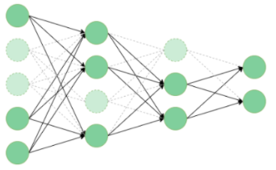
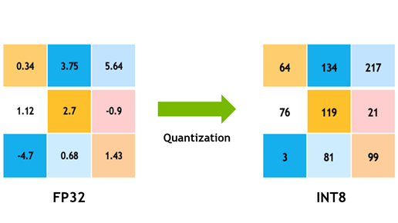
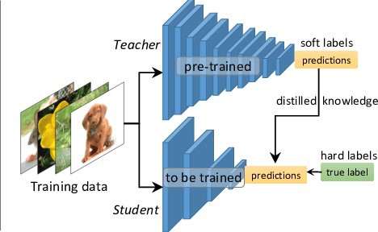
Model Compression
Pruning
Quantization
Distillation
Remove layers / weights / neurons
Reduce size of representation
Replace with a smaller model
Notes:
The common way of compute reduction that exist today is model compression. Here, the idea is to reduce the size of the models, and hence incur reduced compute cost, using ML techniques such as pruning, where we remove layers or weights or neurons, quantization, where we reduce the size of the parameter representation, or distillation where we teach a smaller model using a larger, teacher model. Unfortunately, compression alone may not be sufficient. With the emergence of autoregressive models, compute demands have increased due to the need for multiple iterations per input, and with increasing model sizes, even compressed models may be prohibitively large. Further, compression reduces the size of the model to a fixed point for *every* input.

Slide 6
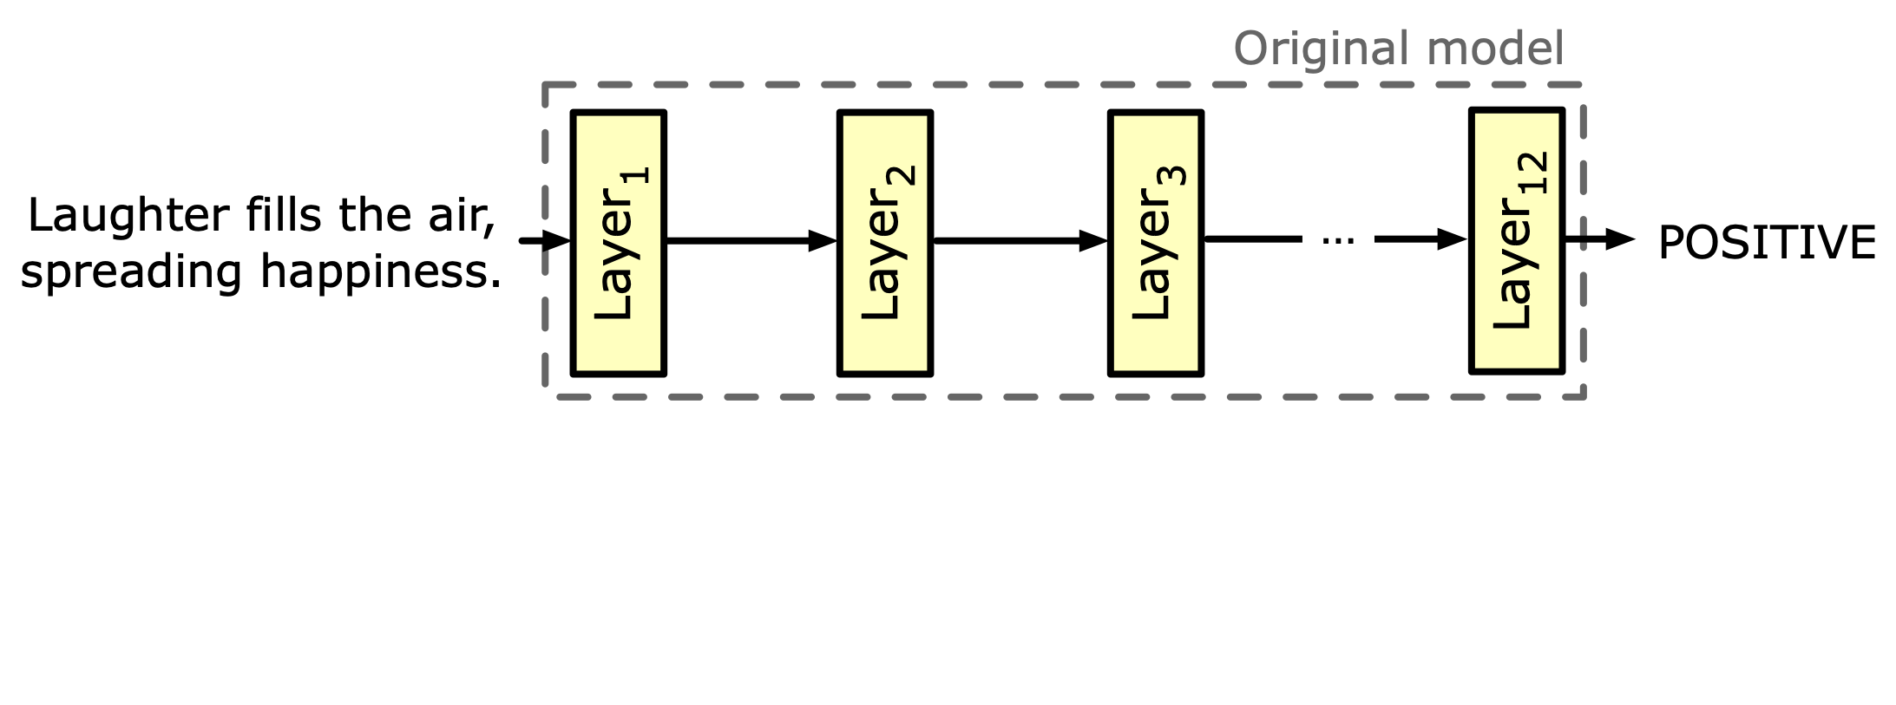
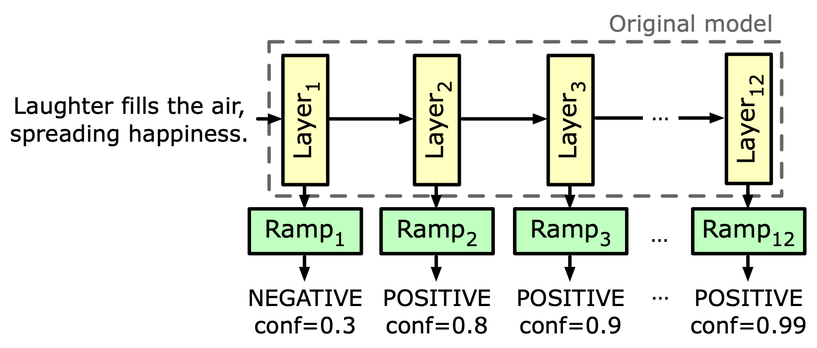
Early Exit Networks
Enables Finer-Grained Inference by adapting execution per input
Augment intermediate layers with ramps (intermediate classifiers)
“Easy” inputs exit earlier to reduce per-request latencies and computation
Exiting decisions: confidence > threshold (e.g 0.7)
Early Exits promise reduced latency and improved throughput
Notes:
Early exits, an ML technique that is complementary to compression, rethink inference at the per-input level,and provide a new perspective to reduce compute.
[CLICK] Here is an example of doing sentiment classification using a standard 12-layer BERT model.[CLICK] the input goes through layers one by one, and a prediction will be generated by a final classifier.
With early exiting, we augment intermediate layers with “ramps” of computation or intermediate classifiers, which work the same as the model’s final classifier. These ramps take in the intermediate layer output, and use it to generate predictions.
The high level idea in EEs is to let easy inputs exit earlier instead of going through the whole model to reduce computation
The exiting decisions are made by comparing the confidence of ramp’s output again a preset threshold. The confidence is defined as the highest prediction score. and if the confidence is higher than the threshold, we exit the input.
In this example, with early exits, we can have an accurate prediction after 2 layers of computation, which provides a direction to optimize the inference at per input granularity
Thus, Ees in theory promise reduced latency and improved throughput, because ideally every input should only incur the optimal amount of compute.

Slide 7
Benefits of Early Exits
Do they deliver on their promise?
EEs can drastically reduce compute while being complementary to compression
Notes:
We investigated whether this is true in practice. Towards this, we performed experiments to understand the latency and throughput improvements from EEs using the GLUE benchmark. The x-axis shows the accuracy and the latency, while the y axis shows tests from the benchmark. We observe that adding EE to stock models resulted in significant savings, of up to 43% with minimal accuracy degradation. To evaluate the complementary nature of Ees to compression, we also applied EE to compressed models. Here we saw that Ees can bring in an additional 11% improvement to compression without any further degradation in accuracy. Thus, Ees can help achieve compute reduction.

Slide 8
Challenges of Early Exiting
Batch size shrinks during execution due to inputs exiting, resulting in significant underutilization of GPUs
Early Exits are incompatible with batching!
Notes:
However, we found that despite such ideal characteristics, Ees have not found practical usage due to one fundamental problem. The key mechanism for obtaining high throughput in DNN serving is to batch inputs to improve resource utilization. Here, we show the effect of Ees on batching – the x axis shows the ramp ids and y-axis shows the batch size and corresponding GPU utilization. We can clearly notice that the batch size shrinks during the execution of the model, resulting in significant underutilization of GPUs. Due to the nature of the current engineering of GPUs and inference frameworks, this dynamism results in Ees performing worse than vanilla models (models without exiting). Our experience working with industry partners indicate that if we are able to resolve the batching & resource utilization problem, then there are significant practical usecases that can benefit from them

Slide 9
E³: Efficient Early-Exits
Makes EE-DNNs practical, and leverages them to enable high-throughput and cost-effective inference
Notes:
In this work, we present E3, a system that makes Ees practical and leverages them for high throughput inference. E3 helps Ees realize their promise of true per-input compute savings and it does so by resolving the batching and its resultant underutilization challenge.

Slide 10
E³: Efficient Early-Exits
Key Idea
Maintain a constant batch size throughout the execution of the EE-DNN
Key Mechanism
Identify contiguous blocks of layers in the EE-DNN that are expected to yield constant batch size outputs
Independently execute and compose the blocks to maintain a constant batch size throughout the execution of the EE-DNN
Notes:
The key idea is E3 is quite simple: it tries to maintain a constant batch size *throughout* the execution of the EE model. It uses two key mechanisms to realize this in practice. The first is to identify contiguous blocks of layers in the model that are expected to yield roughly constant sized outputs, and second is to execute and compose these contiguous blocks to maintain the batch size to be roughly constant during the model’s execution. I will explain the core of E3’s techniques in further details in the rest of the talk.

Slide 11
1. Observing Exit Profile
Build exiting profile by observing the exit behavior at ramps
Layer₁
Layer₂
Layer₃
Layer₄
Layer₅
Layer₆
Input Batch
Size = 16
Ramp₁
Ramp₂
Ramp₃
Ramp₄
Ramp₅
Ramp₆
1 input
exits
1 input
exits
6 inputs
exit
2 inputs
exit
2 inputs
exit
4 inputs
exit
Notes:
E3 starts by observing the EE model to build an “exiting profile”, or the behavior of how the ramps are allowing inputs to exit the model. To illustrate, consider a 6-layer model example augmented with exits after every layer. Given an input batch of certain size (16 in this case), during the execution, ramps will allow inputs to exit based on the predetermined thresholds. For instance, here we see a few inputs exiting at the first few layers, and the number increasing as the computation progresses through the model. E3 keeps track of input sizes and output sizes at each ramp, which it uses

Slide 12

2. Forecasting Exit Profile
Use a simple time-series based technique (ARIMA) to forecast batch shrinkage over a sliding time-window
Layer₁
Layer₂
Layer₃
Layer₄
Layer₅
Layer₆
Ramp₁
Ramp₂
Ramp₃
Ramp₄
Ramp₅
Ramp₆
Notes:
To build an exit-profile forecaster. The idea is to continue observing this exit profile over sliding windows, and use a simple time-series technique, ARIMA in our case, to build a forecast for how an input batch would shrink over the ramps in the model in the near future. The job of the forecaster is to predict the size of outputs, in relative terms, compared to the inputs. We note that E3 doesn’t depend on high accuracy of this forecast, rather, it just uses it for planning purposes as I’ll describe. The forecaster continuously runs in E3, and in our current implementation we use forecast windows of size 2 minutes, but in practice we have observed that changes to batch profiles do not happen in such short intervals, rather only in the order of hours.

Slide 13
3. Identifying split points
Use the batch profile forecast as a guide to identify split points.
Layer₁
Layer₂
Layer₃
Layer₄
Layer₅
Layer₆
Input Batch
Size = 16
Ramp₁
Ramp₂
Ramp₃
Ramp₄
Ramp₅
Ramp₆
1 input
exits
1 input
exits
6 inputs
exit
2 inputs
exit
2 inputs
exit
4 inputs
exit
50% reduction
Notes:
E3 uses the batch profile output from the forecast as a guide to inform its decision to split the EE model. Bringing back our example of the 6-layer model, looking at the exit patterns here, we notice that there’s a 50% reduction in the input batch by the time the model completes executing the third layer. When this is indicated by the forecast, E3 can utilize this information to split the model at layer 3, resulting in two splits, the first consisting of the first 3 layers in the model, and the second consisting of the remaining 3.

Slide 14
4. Model-parallel execution
Execute the splits in a model parallel fashion
Layer₁
Layer₂
Layer₃
Layer₄
Layer₅
Layer₆
Ramp₁
Ramp₂
Ramp₃
Ramp₄
Ramp₅
Ramp₆
E3 can leverage heterogeneous hardware to execute the splits
Notes:
Once the splits are identified, E3 then leverages model parallelism to execute them independently, potentially on different GPUs. Notice that each of the splits represent contiguous layers that take in a fixed sized input batches and produce roughly fixed size output batches. In our example, the first split takes in batches of 16, enables exiting for 8 of them, and outputs batches of 8, which matches with the expected input at the second split. While in this case, the splits are equal in size of 3 layers each, in practice this need not be. Due to the model parallel nature of execution, E3 can also leverage heterogeneity of resources, if available, and can benefit from it.

Slide 15
5. Replicate splits
Compose splits to maintain overall batch size
E³ pipelines the execution to overlap computation and communication across splits
Input Batch
Size = 16
Layer₁
Layer₂
Layer₃
Output Batch
Size = 8
Layer₄
Layer₅
Layer₆
Ramp₁
Ramp₂
Ramp₃
Input Batch
Size = 16
Layer₁
Layer₂
Layer₃
Output Batch
Size = 8
Ramp₄
Ramp₅
Ramp₆
E³ can disable ramps inside splits for removing the exit checking overheads
Ramp₁
Ramp₂
Ramp₃
Notes:
In order to maintain the overall batch size, E3 then replicates and composes the splits. In our example of input batch size of 16, and forecast of batch size shrinkage by 50% at the split, we can replicate the first split twice. Each replica takes an input of size 16, exits 8 and outputs a batch of size 8 to be forwarded to the second split. The second split need not be replicated, as it can combine the two outputs to form a batch size of 16, thus maintaining the overall batch size to be the same. Recall that E3 doesn’t need perfect forecasts. This is because even if we don’t end up with exact 50% reduction, we do not affect the correctness of the execution. For example, if the batch size at the output of split 1 ends up being 10 instead of 8, we can still execute it albeit with a small loss in performance. Since E3 needs to incur communication between splits, it pipelines the execution to overlap computation and communication. Finally, since each split is independent, E3 can disable the ramps inside the splits to further mitigate the overheads of exit checking.

Slide 16
E³’s Optimization Problem
EE-DNN
Split Locations
Request Rate
E³ Optimizer
Number of Replicas
Batch Profile
Resource for Each Split
Resources
Details of the optimization formulation in the paper!
Notes:
While I described the techniques in E3 using a simple example, E3 formalizes this as an optimization problem. The optimizer takes in a number of parameters, such as the EE model, the desired request rate, batch profile from the forecaster, and available resources and outputs the split locations, the number of replicas of each split and the resource on which each of them should be run by solving the optimization problem using a DP based implementation. Further details of the optimization formulation could be found in our paper.

Slide 17
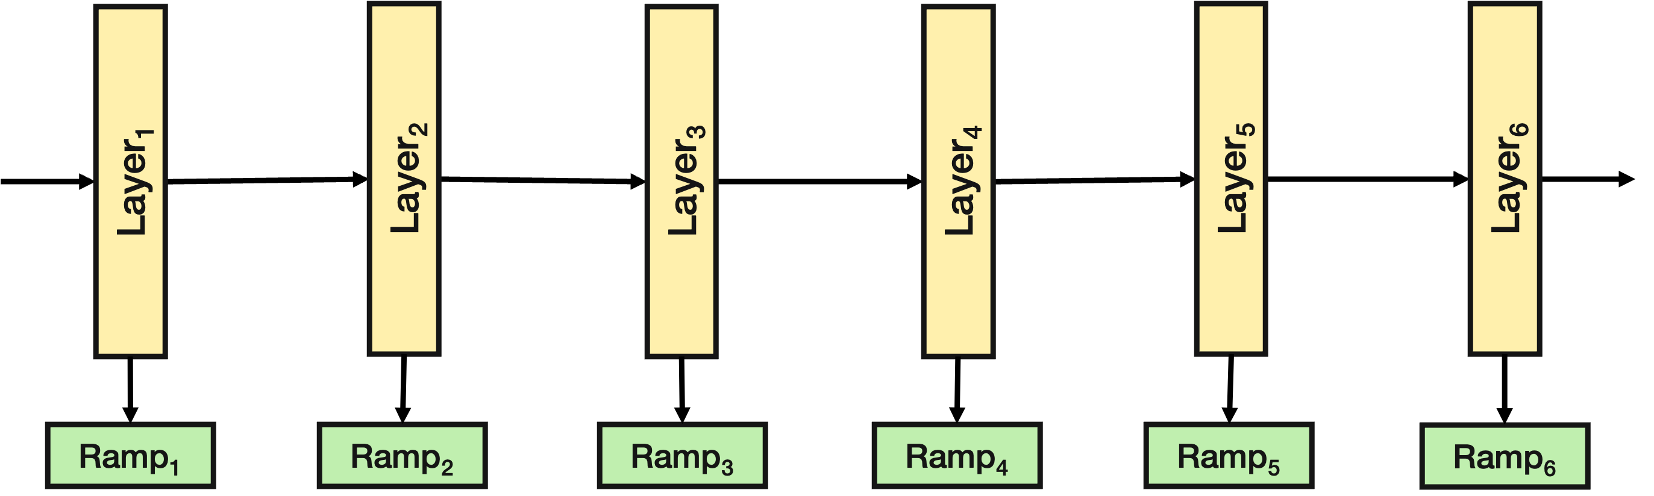
E³: Efficient Early-Exits
3
4
1
2
Config/Requirements
Notes:
E3 implements the forecaster and optimizer along with other components in its scheduler. Currently E3 is implemented as a shim layer on top of TorchServe with native ORT support, but the implementation is modular and can be carried over to other frameworks. The implementation takes in the EE model and requirements, and uses the profiler to observe the behavior and build the forecast. The optimizer then determines the splits which are then replicated and executed by the scheduler on the available resources. The feedback from the execution is continuously monitored and changes are made as appropriate.

Slide 18
Evaluation
Evaluated in a cluster of up to 46 GPUs
Mix of NVIDIA A6000, V100, P100, K80
Compared against a variety of baselines
Vision: ResNet, BranchyNet
NLP: BERT, DeeBERT, DistillBERT
Autoregressive Models: T5, CALM, Llama
Goodput: # of samples/sec sustained without SLA violation
Notes:
We have evaluated E3 on a 46 node cluster consisting of heterogeneous GPUs. We compared E3 against a variety of baselines, both in vision and NLP. In vision, we compare E3 on resnet and its EE variant BranchyNet. In NLP, we compare E3 on BERT, its EE variant DeeBERT and a compressed variant DistillBERT. We also evaluated E3 on two familes of generative models: the T5x family from Google, and Llama family from Meta. Our primary metric of evaluation was goodput, which is the number of samples that the system can sustain per second without SLA violations. We set the SLA to 100 ms following recent work.

Slide 19
NLP Models
Evaluated on the GLUE benchmark
EE models do better when batch sizes are small
As batch size increases, EE models become worse
E³ can improve on both EE and vanilla models (1.4x improvements)
Notes:
The first result shows the performance of E3 on non generative NLP model. The x-axis shows the batch size and the y-axis shows the gooput. Here, higher bars indicate better performance and hence desirable. We can see that EE models show good performance when batch sizes are small, but become worse as batch sizes increase. At batch size 4, they are worser than the stock model without exits. On the other hand, E3 is able to improve upon both stock and ee models for all batch sizes. The performance increases with increasing batch size.

Slide 20
Resource Heterogeneity
If we hold cost the same, can E³ benefit from heterogeneous resources?
EE models work better with cheaper GPUs
Vanilla models benefit from powerful GPUs when batching opportunities exist
E³ effectively utilizes heterogeneous resources (1.7x improvements)
Notes:
Next, we evaluate the ability of E3 to leverage heterogeneous resources. For this, we hold the cost constant and build a heterogenous cluster that costs the same as a homogeneous cluster we used in the previous experiment. Here, we see that EE models are better suited in cheaper GPUs, because of their batch size limitations. On the other hand, stock models can benefit from better GPUs as long as batching opportunities exist. In contrast to both, E3 is able to effectively leverage heterogeneity with up to 1.7x gains.

Slide 21
Cost Effectiveness
Can E³ reduce the cost of inference for fixed throughput requirements?
E³ uses less resources for a fixed throughput
Notes:
To evaluate the ability of E3 to reduce the inference cost, we conducted experiments that hold the throughput requirements constant. We consider two scenarios, first where we consider homogeneous resources. Here, we investigate how many GPUs are necessary for each system to sustain the given throughput. We see that E3 is able to achieve it using the least number of GPUs. Second, we evaluated the cost for sustaining a fixed throughput. Here, we allow heterogeneous GPUs due to their pricing. Here too, we see that E3 is able to achieve the desired throughput at the lowest cost.

Slide 22
Compressed Models
Is compression alone enough? Can E³ enhance compression?
Compressed models leverage EEs better than counterparts
Compressed models still leave a lot on the table!
E³ complements compression techniques (1.67x)
Notes:
Here we evaluate the complementary nature of early exits. For this, we extended distillbert, a compressed version of BERT with early exits. We see that compressed models, due to their compute reduction, perform significantly better than stock models. E3 can complement them further eek out performance, in this case up to 1.7x. This indicates that while compressed models are able to significantly improve the landscape, they still leave a lot on the table and that combining them with Ees can be beneficial.

Slide 23
Generative Models: CALM
EE model that enables exiting on Google’s T5x model
Machine translation 2.84x
Document summarization 3.8x
Notes:
Finally, we evaluated E3 on generative models. In the first experiment, we evaluate it against CALM, an EE model that introduces exiting on Google’s T5x encoder-decoder model. We used two tasks, a translation and a summarization task to show the common usecases for generative models. We see that in generative scenarios, where multiple iterations are necessary for each input, E3 can provide significant boosts. The performance increases with summarization task, where the average tokens generated per input is approximately 18.

Slide 24
Generative Models: Llama Family
Generality of E³ to decoder-only autoregressive models
Exit checking at ramps have significant overheads
Such overheads increase with larger models
E³ can mitigate overheads and boost performance (1.48x)
Notes:
In the second experiment, we evaluated the generality of E3 to decoder-only models by using the Llama family. We note that an EE variant of Llama is not available, so we existing guidance to design ramps. We notice that compared to other models, the exit checking overheads are significant, especially with larger models and the trend is likely to continue. E3 is able to boost the performance here too, and shows tat the techniques are generally applicable to diverse autoregressive architectures.

Slide 25
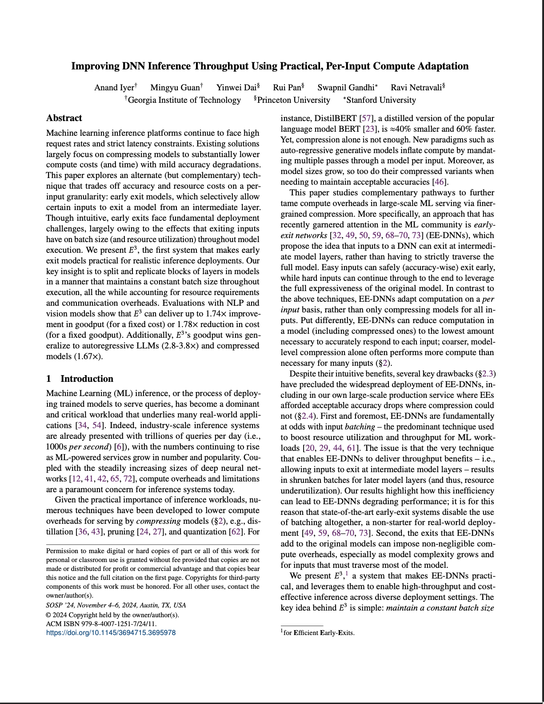
Other Evaluations
Several other experimental results available in the paper
Overheads of E³
Generality to other EE architectures
Latency improvements
Effect of error tolerance
Workload variations
Ablation studies on forecaster
Notes:
Although I have only discussed a few evaluations here, the paper contains comprehensive evaluations that look at other aspects such as the overheads, latency improvements and workload variations.

Slide 26
Summary
Compute reduction & resource efficiency crucial for DNN inference
Compression alone may not be sufficient
Early-exits offer a compelling choice towards per-input adaptation
However, does not deliver on its promise
E³ enables early-exits deliver on their promise
Delivers practical, per-input compute adaptation
https://www.anand-iyer.com
Notes:
To conclude, compute reduction and effiently using available resources is becoming increasingly critical for DNN inference. While Ees offer a compelling choice that can adapt computation per input and complement existing compute reduction techniques such as compression. theyEes fail to deliver on their promise. E3 empowers Ees to deliver on their promise by helping them deliver practical, per-input adaptation.

